Slide 1
Organizational Design Step 4 - Process & People Task Design
Feriha PALAZ

Slide 2
The step-by-step approach
Step 1: Getting started
Step 2: Strategy
Step 3: Structure
Step 4: Process and people
Task design
People
Leadership and Organizational Climate
Step 5: Coordination and control

Slide 3
Task design - previous aspects
Main question: how should an organization’s task be designed to perform its work?
Following our basic assumption, a complete organization performs a very large task (mission, high level task) which must be broken down into smaller tasks in order to get the work done.
We set the structure of our organization (configuration, complexity; geographic location, knowledge exchange) considering the foundations
We need, after, to decompose organizational tasks into subtasks empathizing the coordination between them in order to meet organizational goals
Subtasks, once created the organization structure, have their own design: operations; big/small customer; Europe/Asia…

Slide 4
Main Question
How should an organization’s task be designed to perform its work?
Basic level: A very large task which must be broken down into smaller tasks in order to get the work done.
How you should divide the work?
Process: design, development, sales, service
Client type: individuals, small business, large business, government

Slide 5
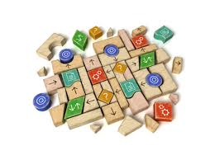
What is Task Design?
Decomposing work into subtasks while considering the coordination among the subtasks to meet organizational goals
Determines the coordination requirements for the firm’s work

Slide 6

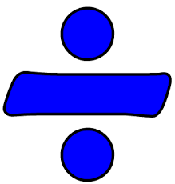
Variables to define task design space
An organization’s task design can be categorized along two important dimensions: repetitiveness and divisibility.

Slide 7
Variables to define task design space
X: Repetitiveness:
If it is high, tasks are well defined and able to be repeated again and again.
High repetitiveness requires standardization in task's execution
A high repetitive task has low uncertainty.
↑ repetitiveness ≡ ↑ standardization (↓ uncertainty)

Slide 8
Variables to define task design space
Y: Divisibility:
If it is high bigger task is broken down into independent subtasks which require little coordination.
Highly divisible means subtasks are independent
Each subtask is normally done by a single subunit
↑ divisibility ≡ ↑ independency (↓ coordination)

Slide 9
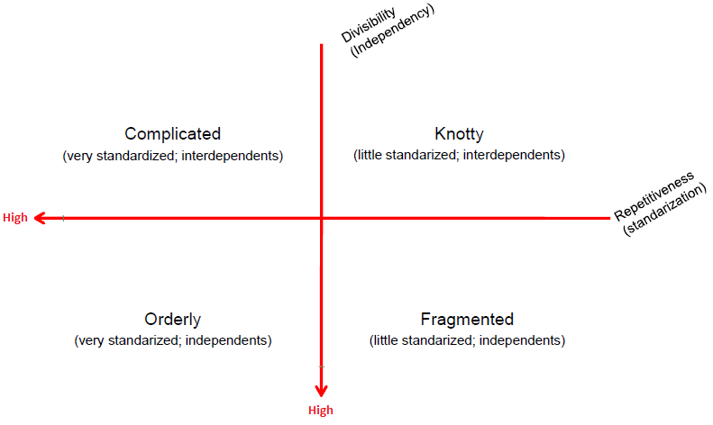
Task Design Space

Slide 10
Orderly
Work is highly divisible and highly repetitive (independent & standarized tasks)
If a single unit experience problems or difficulties turn to manager for solve it.
No coordination required among units.
Within each unit the tasks are standardized as much as possible so they can be easily repeated.

Slide 11
Orderly
Advantages
problems in one unit do not affect others in their work.
every unit can work independently of each other
Executive level must assure that every worker has something to do.
Example: Corparate/private loans in a bank

Slide 12
Complicated
Low on divisibility and highly repetitive.
↑ standarized - ↑interdependency
High degree of coordination required (interdependence of tasks)
Subtasks can be performed by different units of the firm, but they are interdependent to get the work done.
Production processes must be very well timed to avoid bottlenecks.
Executive level focuses on coordination of connected processes.
A breakdown in any subtask can shut down the whole operation.
High level of information processing required.

Slide 13
Complicated - Example
Example: manager of hospital emergency:
1 – admission
2 – triage screening
3 – focused care
4 – release
Suits processing of large volume of work.
Other examples:
- Automobile assembly line
- Fast Food
Given the low divisibility, a breakdown in any one small task can shut down the whole operation .

Slide 14
Fragmented
High on divisibility and low on repetitiveness.
↓ standarization - ↑ independency
Requires less coordination than complicated tasks due to high divisibility/independency of tasks.
Subunits can take creative approaches and process the work at its own place (Focus on Innovation!)
Typical for R&D.
No repetitiveness/low standarization requires a lot of adjustments, but as tasks are not connected, coordination requirements are minimal.
Executive level assures that the subtasks have resources, but is not involved in detailed coordination.

Slide 15

Fragmented - Example
Example : software developer firm that is trying to grow its business, Investment bank.

Slide 16
Knotty
Low on both divisibility and repetitiveness.
↓ standarized - ↓ independency: not standardized and very interdependent tasks
Complex design because is necessary to find ways to coordinate work among subtasks and at the same time support the nonrepetitive approach to doing the work.
Encourages subtasks executive's to develop innovative ways to do their job (accommodating unique demands of each customer and achieving integration with other units).
Typical for new products.
Executive focuses on subunits coordination and resources availability for subunits.
Huge information processing demands.

Slide 17
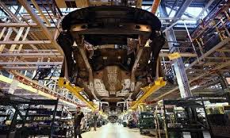
Knotty - Example
When products are new , the knotty approach to task design is often favored by managers.
Example: New Production Development in automobiles at Toyota or Renault

Slide 18
Let’s remember
Misfits
overload the executive management
Decrease performance of firm
What is Misfit?
Any set of relations which do not fall within one column (in the following table)
There are very large number of possible misfits

Slide 19
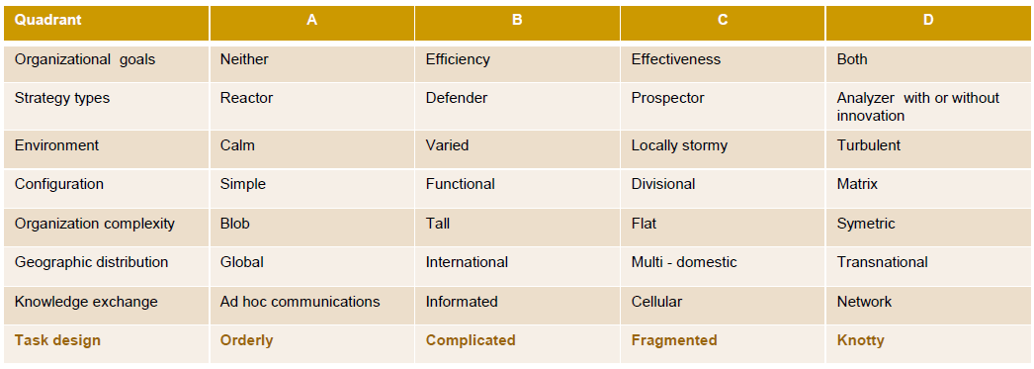
Fit and Misfit Table

Slide 20
Thanks…
Feriha PALAZ

